Slide 1
General Engineering Interventions to COVID-19 Challenges
By
Dr. O. P. Akinyemi
Chemical Engineering Dept.
Lagos State University
August, 2020

Slide 2
Outline
Degree of Impacts of the COVID-19 pandemic
The Challenges
Engineering interventions
Conclusions
Recommendations

Slide 3
Degree of Impacts of COVID-19 Pandemic
As at 5th August 2020,
Confirmed cases = 18,142,718
Death cases = 691,013 worldwide.
(WHO)
Confirmed cases = 44,433
Death cases = 910 in Nigeria.
(NCDC)

Slide 4
The Challenges
Exposure of healthcare professionals to risk of infection,
Non-medical and medical PPE availability,
Limited supply of medical equipment for treatment (e.g. Ventilator),
Testing rate,
Disease spread through surface contacts, etc.

Slide 5
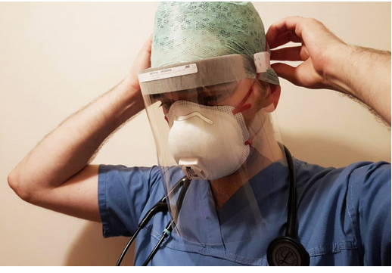
Engineering Interventions
Application of 3D printing technologies to mask, face shield and individual oxygenators production

Slide 6
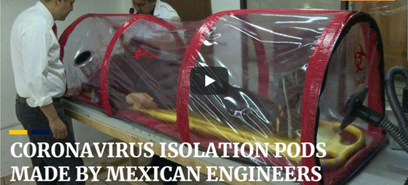
Corona Virus Isolation Pods
-ve Pressure No loss of fluid if plastic
lining tears

Slide 7
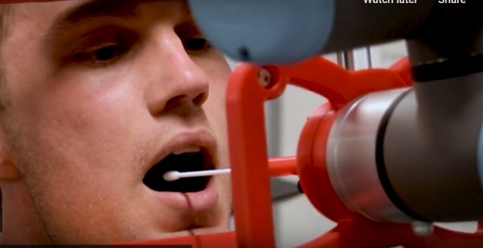
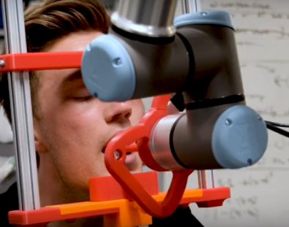
Robotics Interventions
Robots For Enhancing COVID19 Testing
UV Light-emitting Disinfection Robots
SWAB AUTOMATIC ROBOT

Slide 8
Drones Adapted For Special Services
Adapted
to spray disinfecting chemicals in some public spaces.
to deliver medical samples

Slide 9
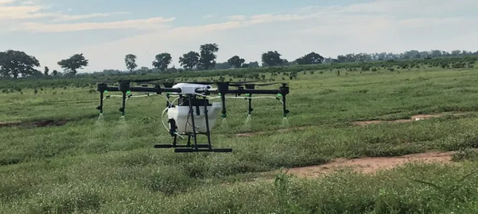
Drones in Operations
XAG Product
Beat Drone Product

Slide 10
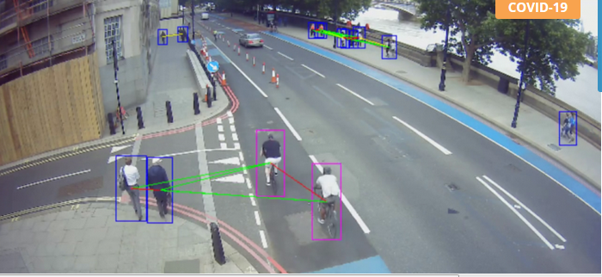
Artificial Intelligence (AI) Traffic Sensors
Artificial intelligence used to analyze self-isolation habits and COVID-19 lockdown protocols.

Slide 11
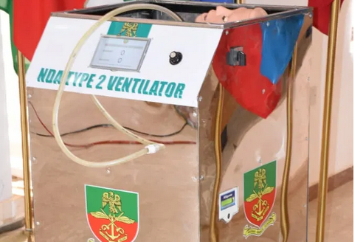
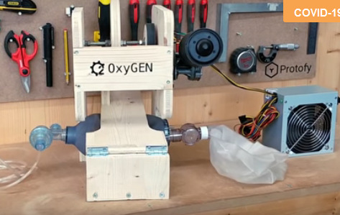
Open-Source Ventilators
Oxford University & Kings College’s Product
Product of NDA

Slide 12
Chemical-Based Walk-Through Disinfection Tunnel (CB-WTDT)
Product of NDA

Slide 13
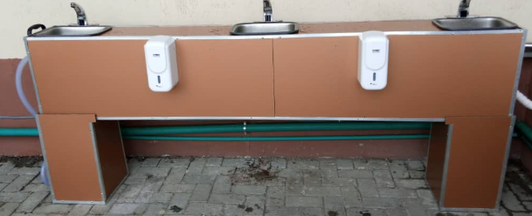
Automated Hand Washing Machine
IMT product
LASU product

Slide 14
On-going Engineering Research Interventions
Engineers are working on how reusable PPE might help fill critical shortages. (Andre Hicks, 2020)
Research funded by National Science Foundation with a one-year, $78,394 Rapid Response Research (RAPID) grant.

Slide 15
Conclusions
Various Engineering interventions have been done while some are on-going to find solutions to the challenges caused by COVID-19 Pandemic.
The interventions are both made at the indigenous level within the country and international level.

Slide 16
Recommendations
Indigenous multi-disciplinary research into the other area of interventions should be encouraged between Engineers and experts from other professions.
Inter-University collaboration towards achieving these objectives should be encouraged.
Government should provide more fund to the universities towards such research areas. [TETFUND current provision is well appreciated]
Industries should collaborate with the universities and research institutes towards achieving the goals.

Slide 17
THANK YOU FOR LISTENING

